Slide 1
16S rRNA Gene Amplicon Survey: Study Design and Case Study
Considerations for a Longitudinal Case Study of Antibiotic Treatment and Virus Infection
Scott A. Handley, PhD Assistant Professor
Department of Pathology & Immunology Washington University School of Medicine

Slide 2
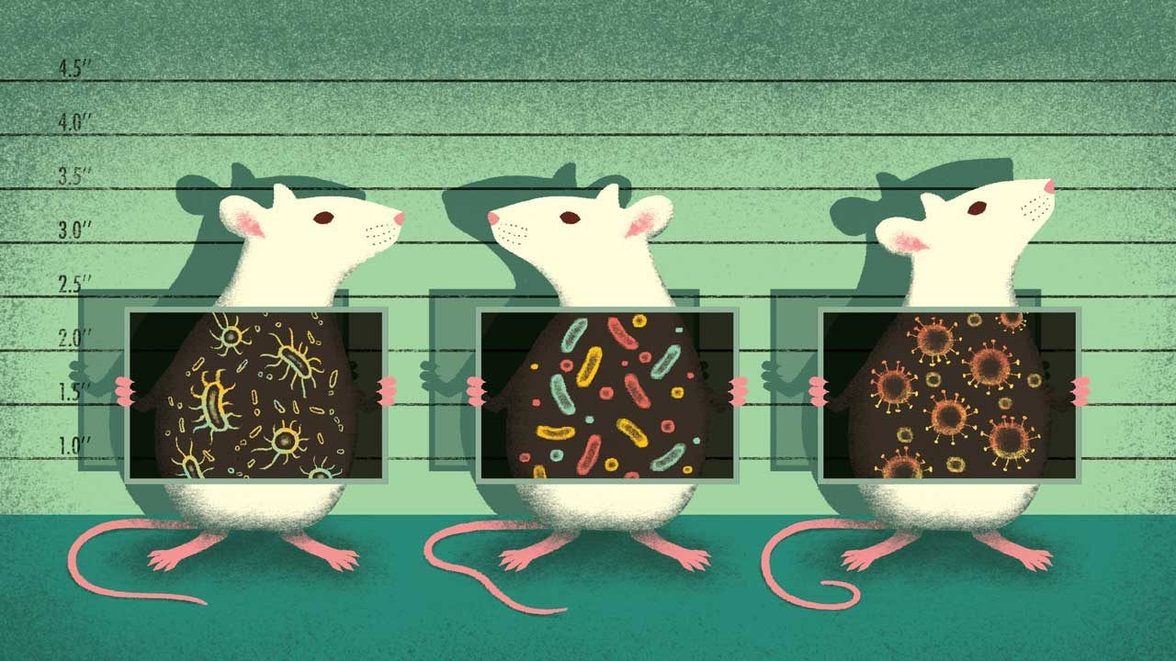
Rationale
16S amplicon surveys are extensively used to study
the mouse bacterial microbiome in a large variety
of contexts
e.g. disease, nutrition, sociology, neuroscience, etc.
Frequently fail due to poor study design
Batch effects
Cage, paternity/breeding, facility, origin effects
Co-housed survival studies (specific example)
Statistical considerations
Detecting signal from noise
Image credit: Davide Bonazzi/@Salmanart
“Mouse microbes may make scientific studies harder to replicate” Kelly Servick. Science Aug 16, 2016
Minimize variance
Filtering out misbehaved data
Many of these principles apply to other data types
“Accounting for reciprocal host-microbiome interactions in experimental science” Stappenbeck, TS and Virgin HW. Nature.
2016 Jun 9;534(7606):191-9
(RNAseq)

Slide 3
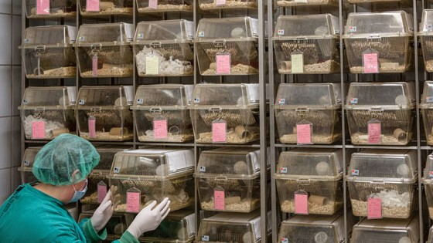

Slide 4
Today’s Case Study
Thackray LB, Handley SA, Gorman MJ, Poddar S, Bagadia P, Briseño CG, Theisen DJ, Tan Q, Hykes BL Jr, Lin H, Lucas TM, Desai C, Gordon JI, Murphy KM, Virgin HW, Diamond MS. Oral Antibiotic Treatment of Mice Exacerbates the Disease Severity of Multiple Flavivirus Infections. Cell Rep. 2018 Mar 27;22(13):3440-3453.e6. PubMed PMID: 29590614

Slide 5

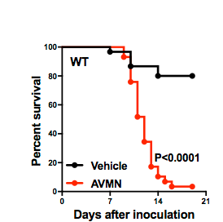

Case Study: Effect of Antibiotics on Viral Pathogenesis
Virus
Time
Antibiotics
Vehicle
Thackray LB, et al.Cell Rep. 2018 Mar 27;22(13):3440-3453.e6. PubMed PMID: 29590614

Slide 6
Cage and Mouse-to-Mouse Effects
Virus
Time
A
A
A
A
?
B
B
B
B
Antibiotics
C
C
C
C
?
D
D
D
D
Kool-Aid

Slide 7






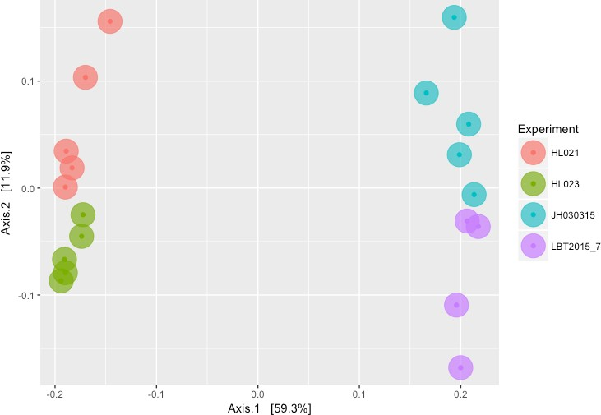

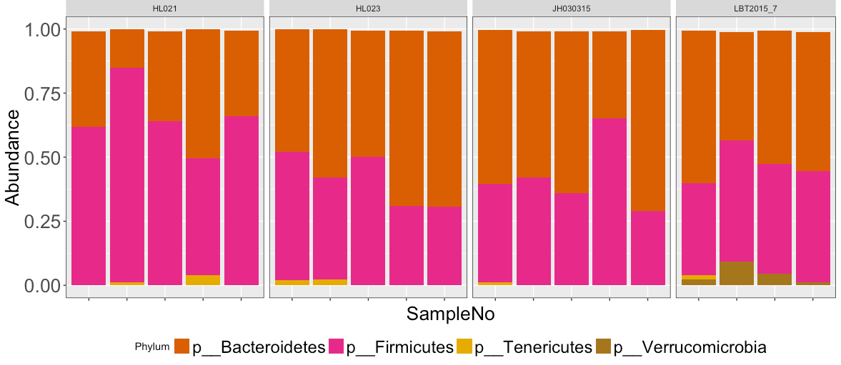



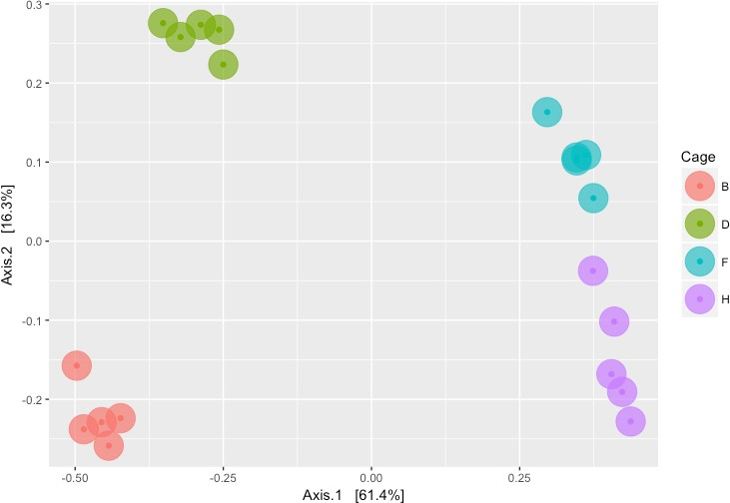


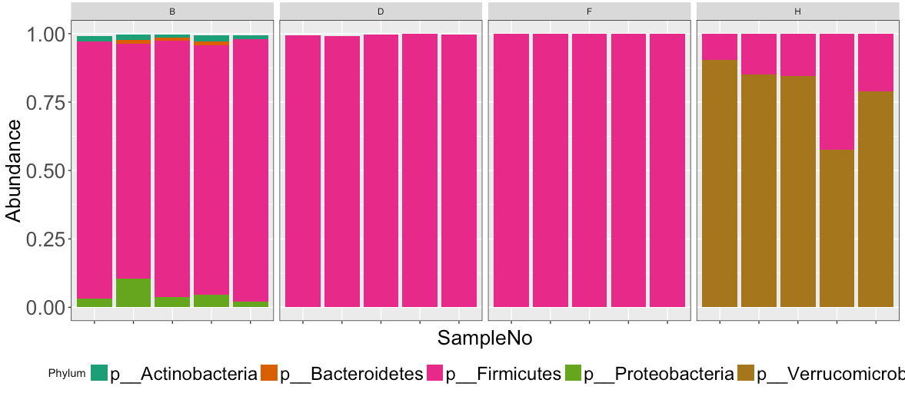
Cage Effects: 14 days post-treatment (pre-infection)
Phyla
Beta diversity
Kool-Aid
Vancomycin

Slide 8

Individual Mouse Isolation Schema
Ampicillin (n=30) or
Kool-Aid (n=15)
Virus
Survived?
Day -14
Day -11 Day -1 Day 2 Day 4 Day 6
A1
A1
A1
A1
A1
A1
No
A2
A2
A2
A2
A2
Yes
A2
A3
A3
A3
A3
A3
No
A
A3
Co-housed 1 Week
A4
A4
A4
A4
A4
Yes
A4
A5
A5
A5
A5
No
A5
A5
Pre-treatment
Post-treatment
Pre-infection
Post-infection

Slide 9
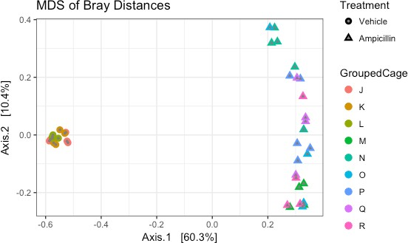
Individual Housing Results

Slide 10
Amplicon Surveys (Highly Opinionated!) Best-practices
It’s the classic garbage in, garbage out all over again …

Slide 11



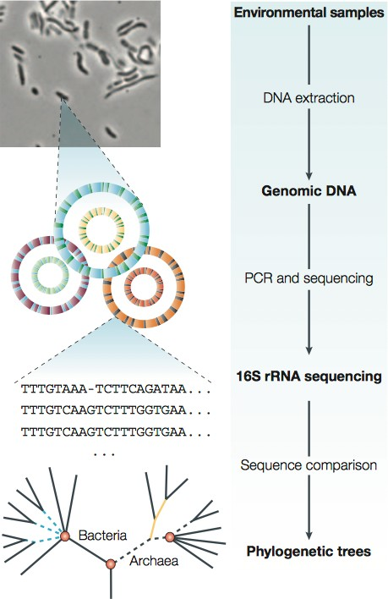






16S rRNA Amplicon Survey
Study Design
Laboratory
Bioinformatics, Ecological Analysis and Statistics
Tringe, S.G., Rubin, E.M. Nat Rev Genet. 2005 Nov;6(11):805-14

Slide 12
Side note: Amplicon Surveys vs. Metagenomics
Please hold your throwing tomatoes …

Slide 13
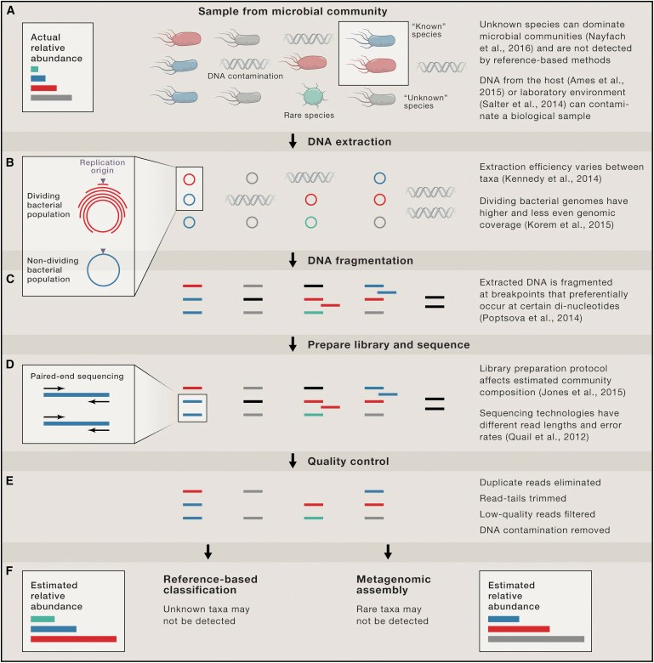
16S Amplicon Surveys vs Metagenomics?
Tringe, S.G., Rubin, E.M. Nat
Rev Genet. 2005
Nov;6(11):805-14
Nayfach S., Pollard KS. Cell. Aug 25;166(5):1103-16

Slide 14
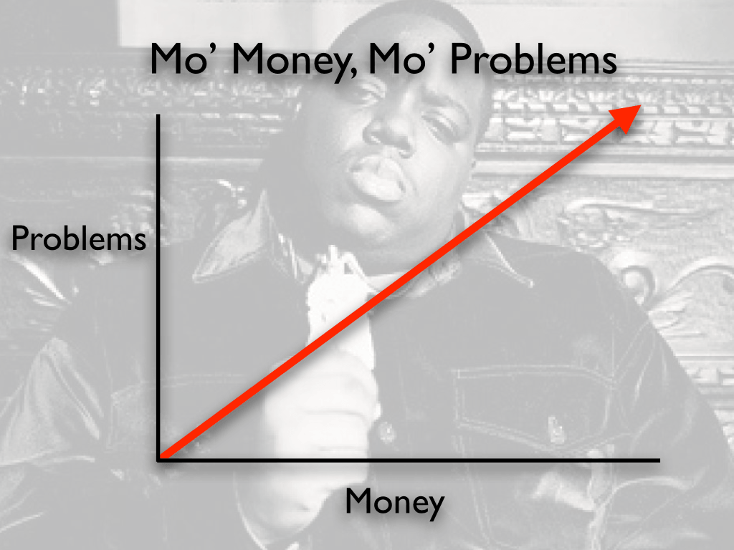
Most of Your Decision Will Boil Down to $$$
Our labs per sample costs:
16S = $17.50 per sample
Metagenome = $225.00 per sample
Has been estimated to be as low as
$100 per sample
Study we will discuss today: 270 samples
$4,725 vs. $27 - $60,750
Other considerations:
Understanding analytical space
Data storage
Image credit: The Internet Quote credit: Notorious B.I.G.

Slide 15
What are the stages of a 16S amplicon computational workflow and how can we create optimal data for analysis?

Slide 16



























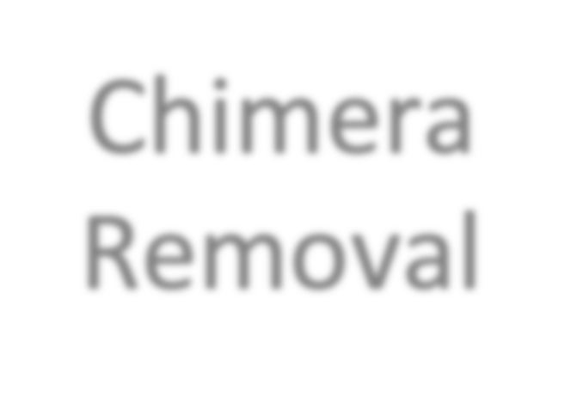







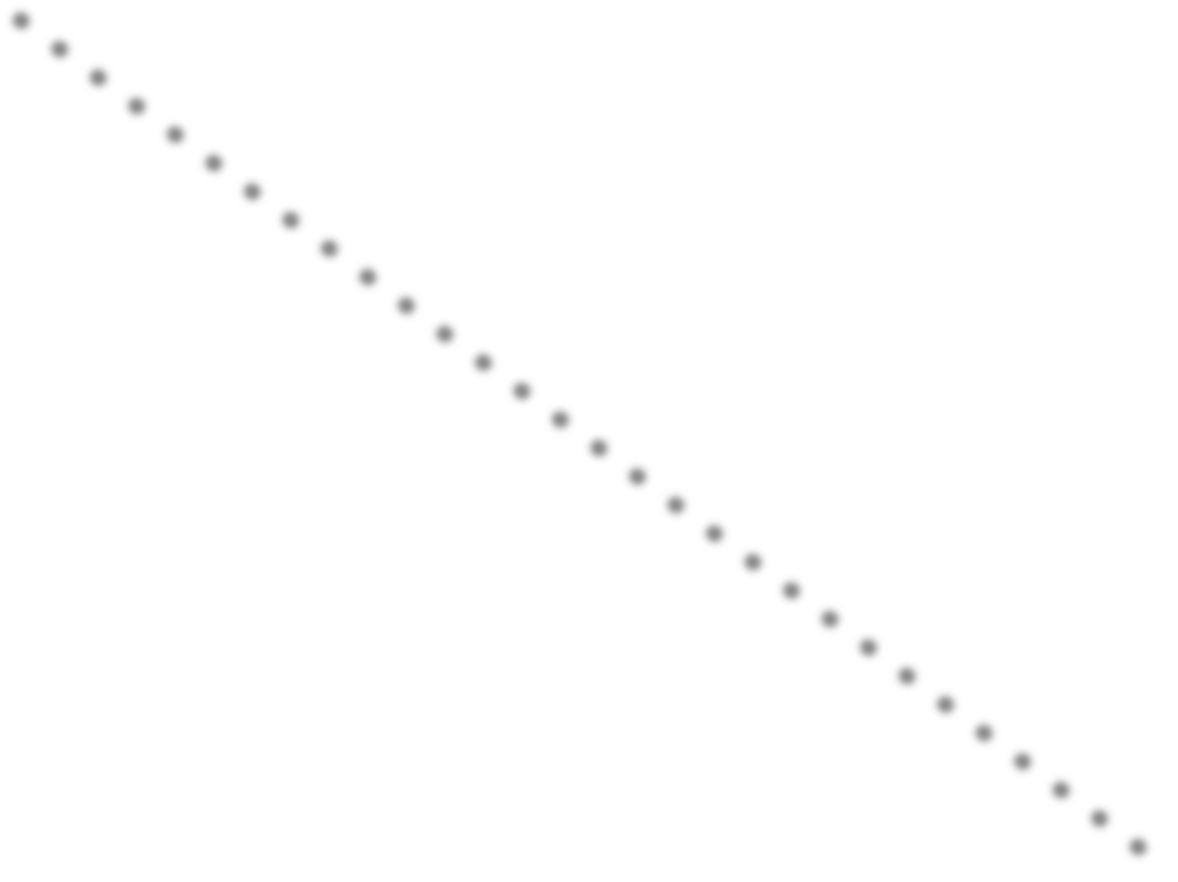
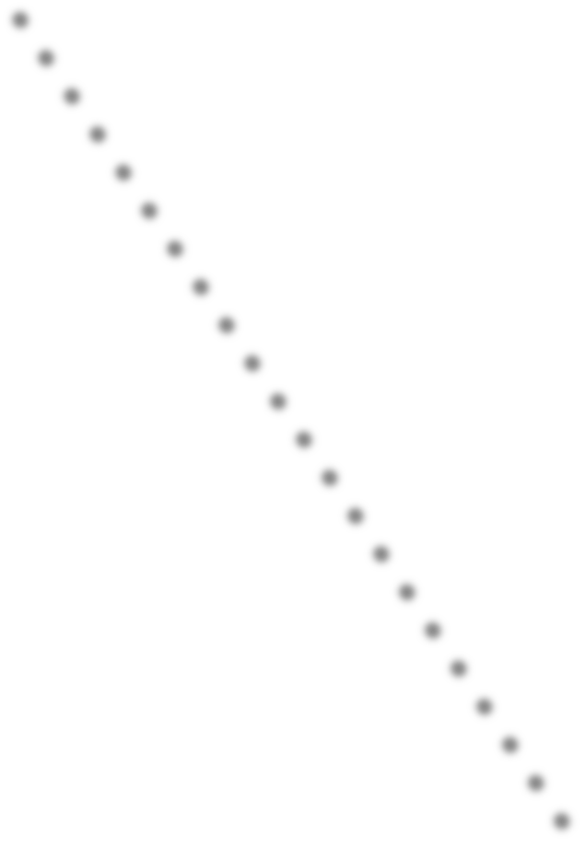
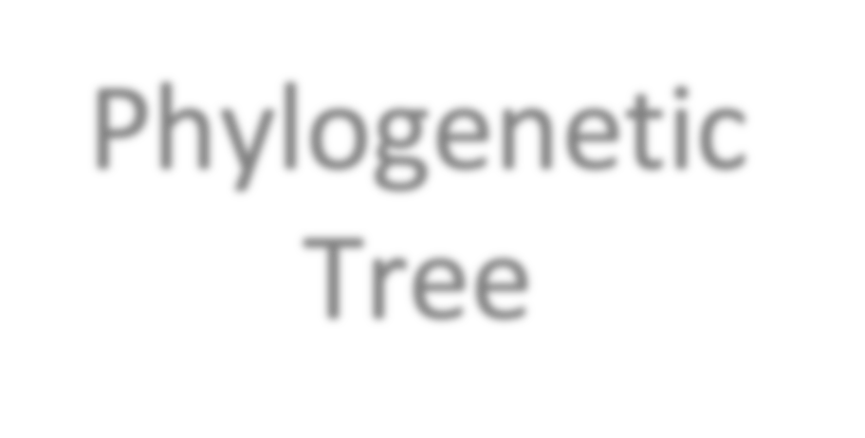




















Raw Data
Software
Researcher Input
QA / QC
*
*
*
*
Clustering
De-replication
/ Counting
Chimera Removal
Taxonomic Assignment
Phylogenetic Tree
Sample QA / QC
Taxon Filtering
Dada2 / R
MOTHUR
QIIME
**
*
PhyloSeq
**
**
*****
Ecological Analysis

Slide 17




















Sequence Clustering
16S RNA Amplicons
Amplicon Clusters
97% Similarity
> 97% identical to OTU
OTU’s are 3% different
UCLUST
UPARSE
SWARM
SUMACLUST
OTHERS
Ambiguous

Slide 18
Recognized Problems with Sequence Clustering
False-positives: 1,000s of OTUs when only 10s of sequences are present
Due to clustering artifact / noisy sequences
Inflates richness (# of species)
Sparse matrices
Poor taxonomic resolution defined by arbitrary radius (e.g. 97%)
Increased financial cost: poor data efficiency
Increased computational cost: Clustering is quadratic
Unstable: Sequence and count frequently depend on input order

Slide 19
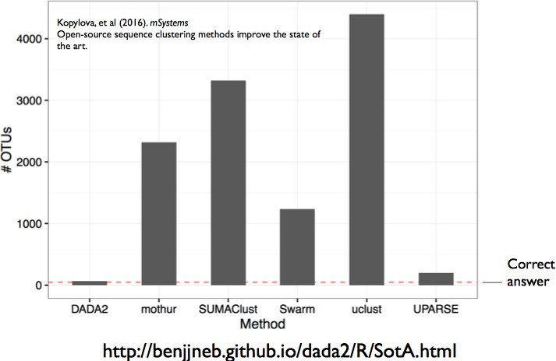



There is some hope
11,112 citations!!!
64 sequences

Slide 20

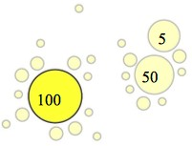
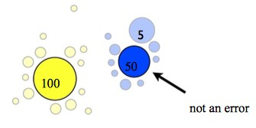
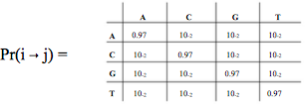
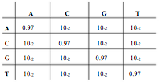
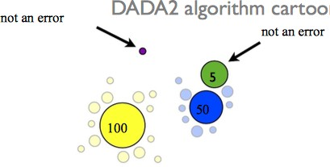
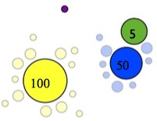
Step 2: Initial error model
Step 1: Initial guess. All sequences + errors
Step 3: Unlikely error under model.
Recruit errors. Update the model
Step 3: Reject more sequences under new model & update
Convergence: All errors are plausible
Dada2: Callahan, BJ et al. Nat Methods. 2016

Slide 21









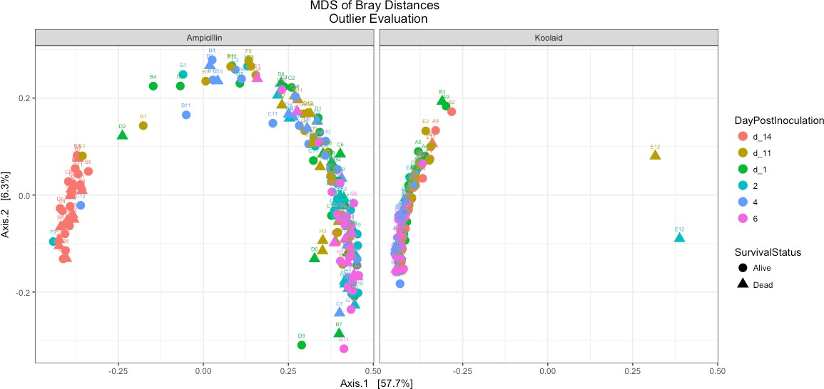



Raw Data
What does all of this work get you?
ID | Sample 1 | Sample 2 | Sample 3 | Sample 4
ASV 1 | 0 | 0 | 2 | 0
ASV 2 | 12 | 8 | 8 | 456
ASV 3 | 112 | 101 | 98 | 10
ASV 4 | 435 | 435 | 382 | 3
ASV 5 | 76 | 83 | 68 | 145
QA / QC
Clustering
De-replication
/ Counting
Chimera Removal
Taxonomic Assignment
Phylogenetic Tree
Sample QA / QC
Taxon Filtering
Ecological Analysis

Slide 22






Sparse Matrix OTU Clustering
Less Sparse Matrix Sequence Resolution
ID | Sample 1 | Sample 2 | Sample 3
OTU 1 | 0 | 0 | 1
OTU 2 | 1 | 0 | 0
OTU 3 | 1 | 0 | 0
OTU 4 | 1 | 1 | 1
ID | Sample 1 | Sample 2 | Sample 3
ASV 1 | 0 | 1 | 1
ASV 2 | 1 | 1 | 0
ASV 3 | 1 | 0 | 1
ASV 4 | 1 | 1 | 1
More noisy than reality
Bad for statistical inference
Multiple hypothesis testing
Poorly defined, difficult to separate distributions

Slide 23










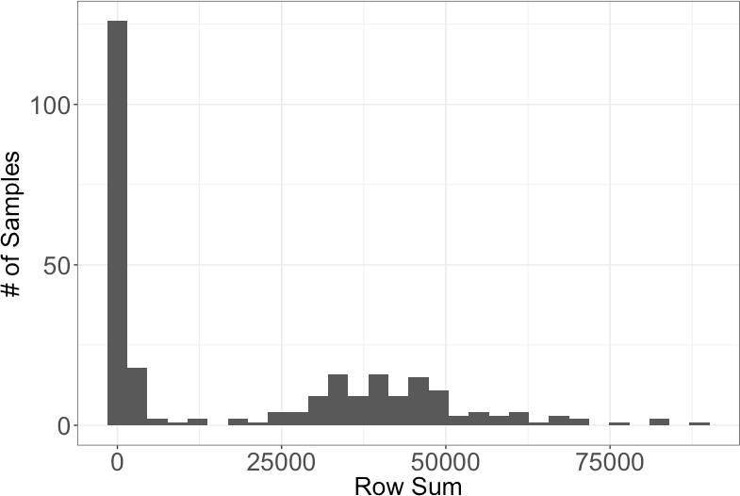


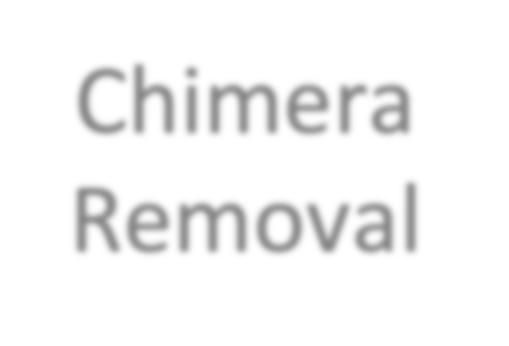





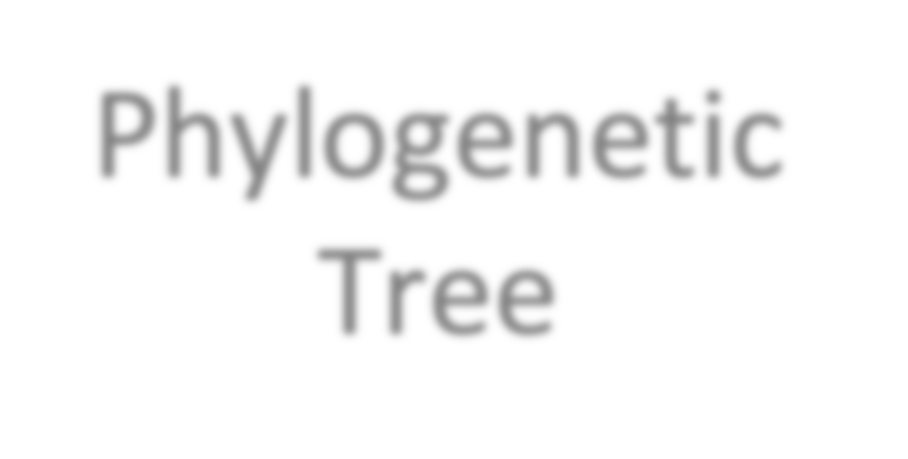











Making Things Normal
Data Transformation
Raw Data
QA / QC
Clustering
De-replication
/ Counting
Chimera Removal
Taxonomic Assignment
Phylogenetic Tree
Sample QA / QC
Taxon Filtering
Ecological Analysis

Slide 24
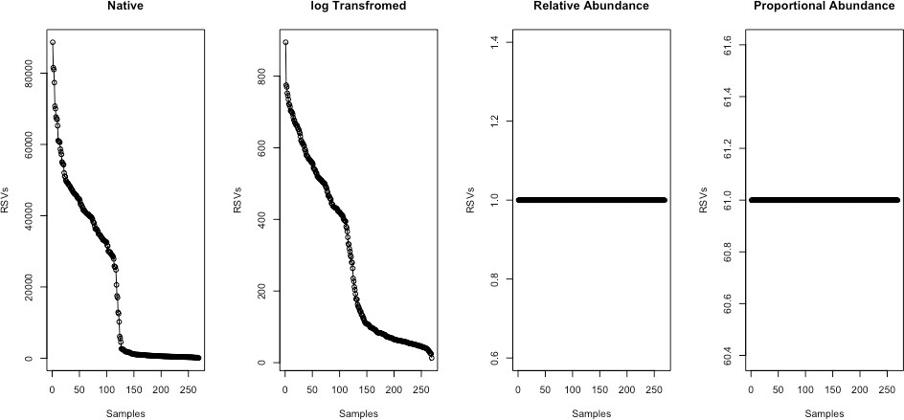
Data Transformation
min(sample_sum) * x/sum(x)
log(1 + x)
x/sum(x)

Slide 25
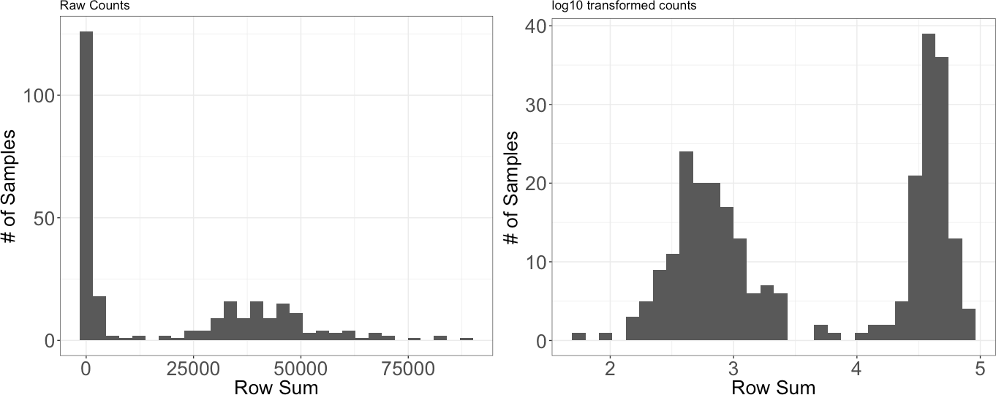
log Transformation Shifts Towards Normality
Weiss S. et al. Normalization and microbial differential abundance strategies depend on data characteristics. Microbiome. 2017

Slide 26











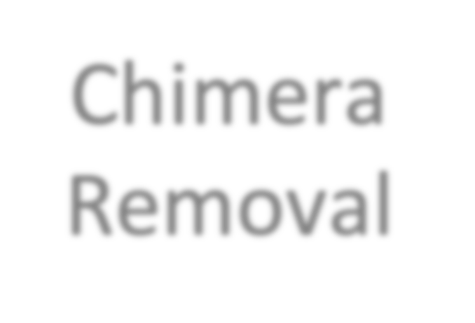




















Sample Outlier Detection
Raw Data
QA / QC
Clustering
De-replication
ID | Sample 1 | Sample 2 | Sample 3 | Sample 4
ASV 1 | 0 | 0 | 2 | 0
ASV 2 | 12 | 8 | 8 | 456
ASV 3 | 112 | 101 | 98 | 10
ASV 4 | 435 | 435 | 382 | 3
ASV 5 | 76 | 83 | 68 | 145
/ Counting
… n=270
Chimera Removal
Taxonomic Assignment
Phylogenetic Tree
…
Sample QA / QC
n=724
Taxon Filtering
Ecological Analysis

Slide 27
Individual Mouse Isolation Schema
Ampicillin (n=30) or
Virus
Survived?
Kool-Aid (n=15)
Day -14
Day -11
Day -1
Day 2
Day 4
Day 6
A1
A1
A1
A1
A1
A1
No
A2
A2
A2
A2
A2
Yes
A2
A3
A3
A3
A3
A3
No
A
A3
Co-housed 1 Week
A4
A4
A4
A4
A4
Yes
A4
A5
A5
A5
A5
No
A5
A5
Pre-treatment
Post-treatment
Pre-infection
Post-infection

Slide 28
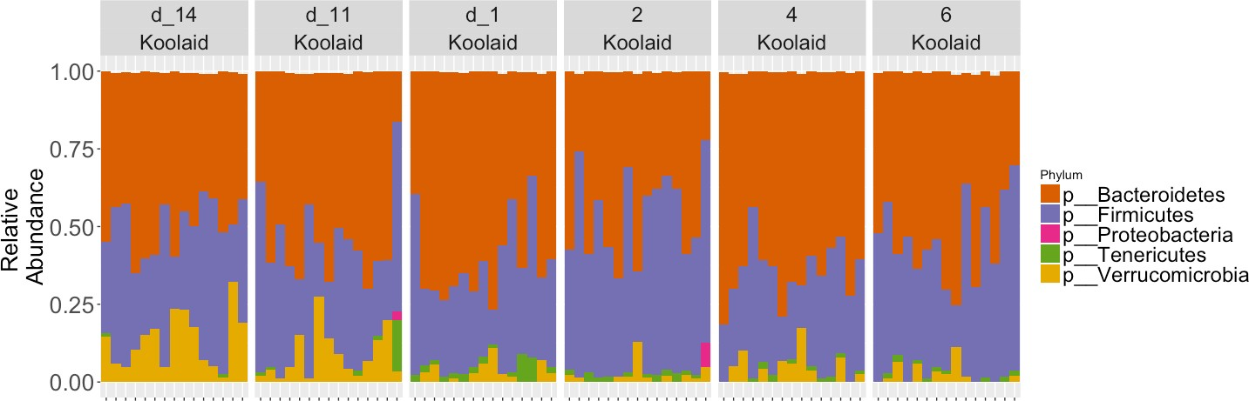
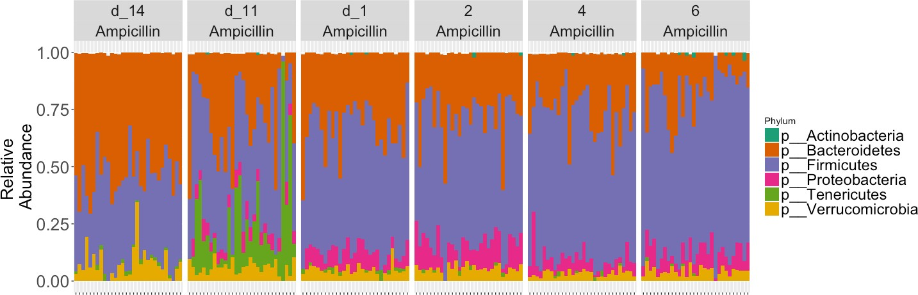
Virus

Slide 29
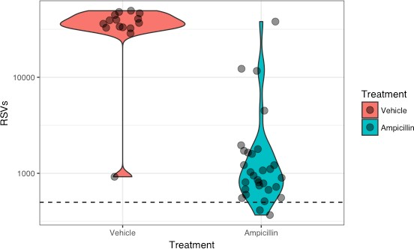
Sample Outlier Detection – Unexpectedly Low # of Sequences

Slide 30
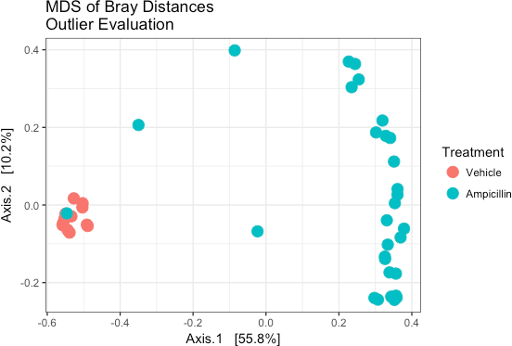
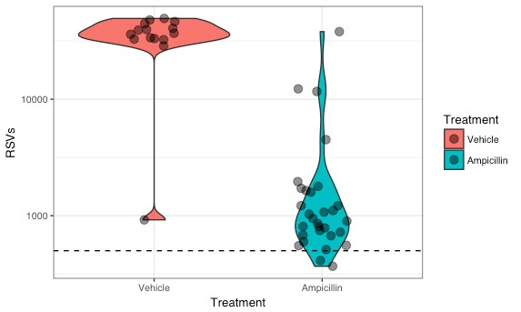
Samples that “perform” unexpectedly

Slide 31
Rules of Thumb for Sample Detection and Removal
Justify and document!!!
Except in extreme cases, test how sample removal alters your downstream results. Do the experiment!
Know your data. When are you comfortable removing a sample based on your knowledge of the system
Explore using multiple plot types
Include enough detail to make analysis interpretable and reproducible

Slide 32
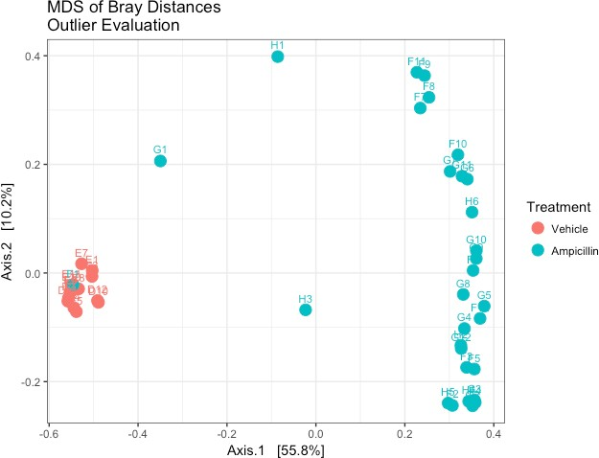
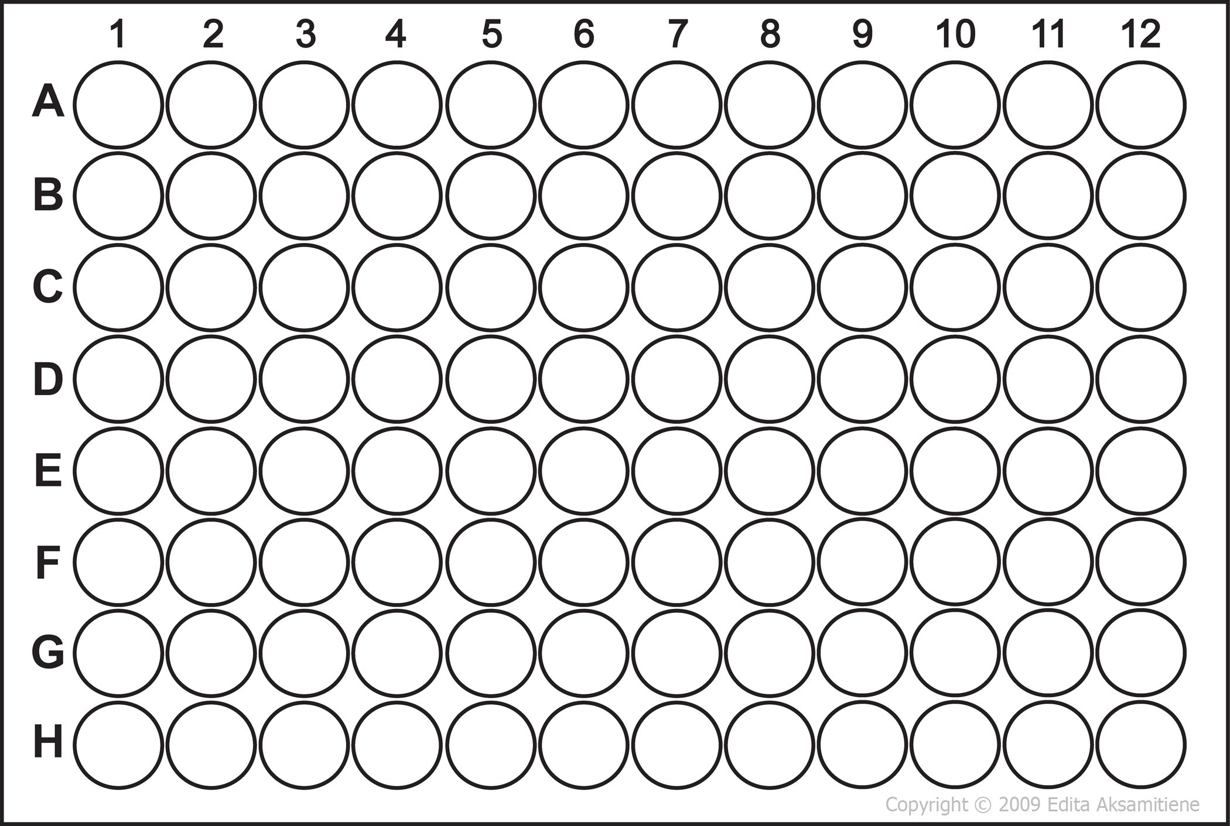
Understand your data better
*
*
* *

Slide 33
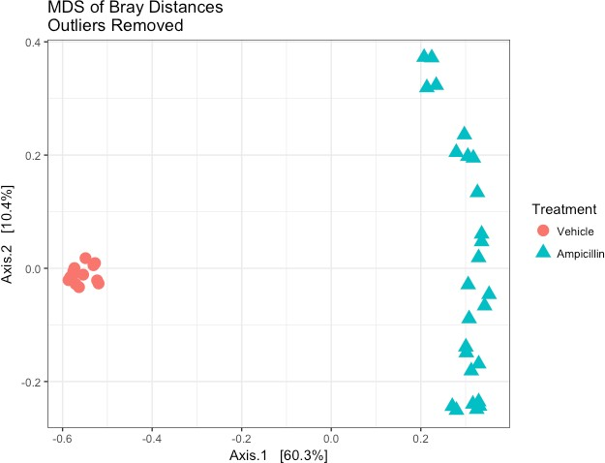
Cleaned Data

Slide 34


Feature Outlier Detection
ID | Sample 1 | Sample 2 | Sample 3 | Sample 4
ASV 1 | 0 | 0 | 2 | 0
ASV 2 | 12 | 8 | 8 | 456
ASV 3 | 112 | 101 | 98 | 10
ASV 4 | 435 | 435 | 382 | 3
ASV 5 | 76 | 83 | 68 | 145
… n=270
… n=724

Slide 35
Low-abundant feature removal is commonplace
“We removed all taxa that were under 1% relative abundance and present in less than 3% of all samples.”

Slide 36
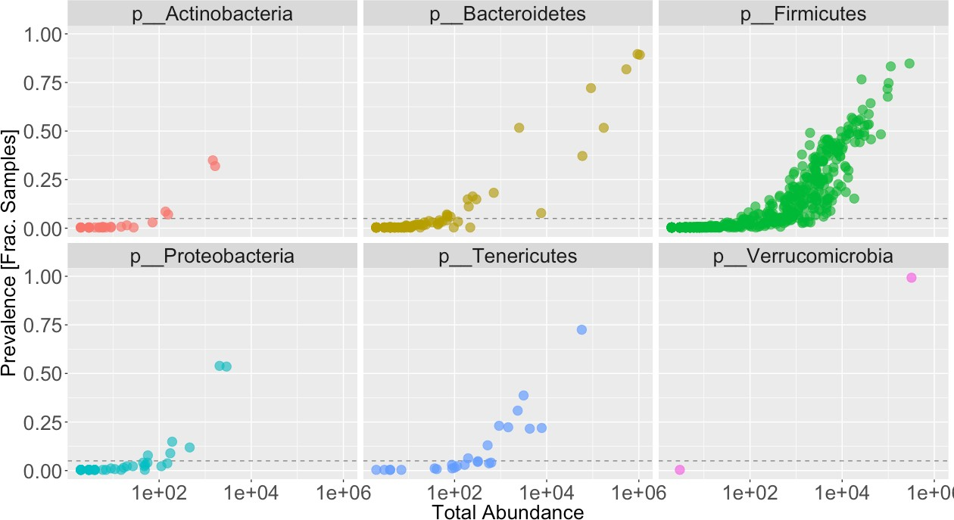
Sequence/Taxa Outlier Detection
Filtering out low impact information

Slide 37
Rules of Thumb for Feature Detection and Removal
Justify and document!!!
Except in extreme cases, test how feature removal alters your downstream results. Do the experiment!
Know your data. When are you comfortable removing a feature based on your knowledge of the system
Explore using multiple plot types
Include enough detail to make analysis interpretable and reproducible

Slide 38
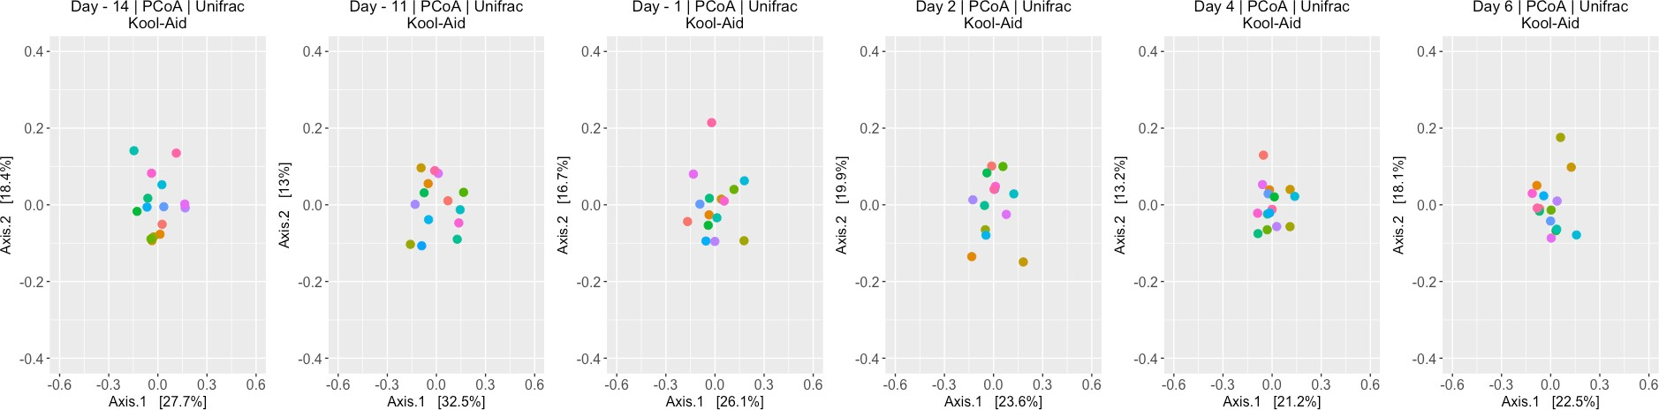



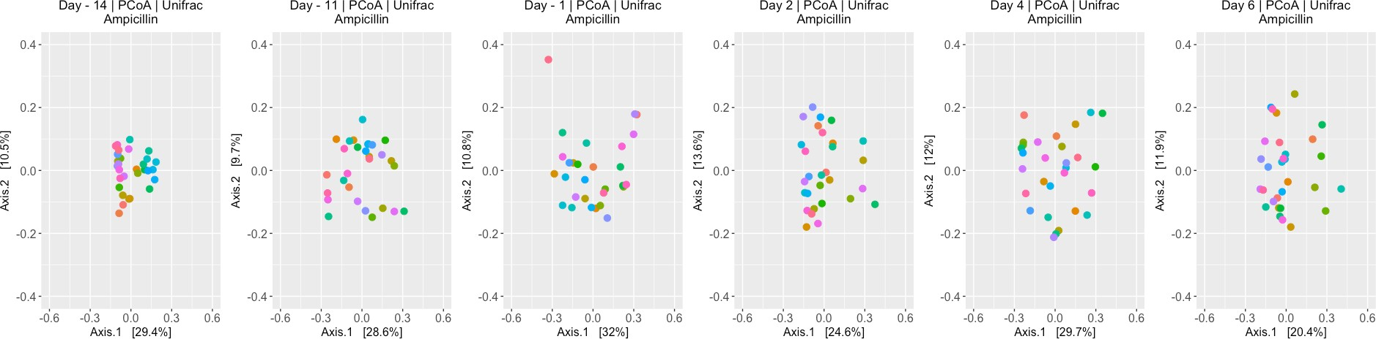
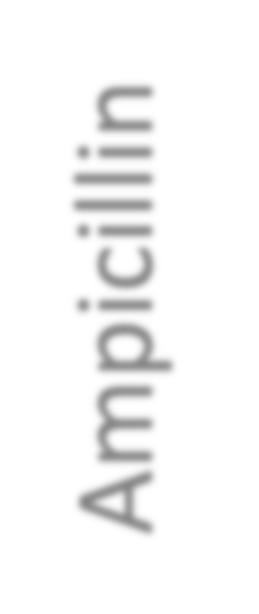


Beta Diversity Throughout the Course of the Experiment
Colored by Cage
Kool-Aid
Ampicillin

Slide 39
Summary
Explore -> Document -> Test
Does any of this really matter?
Sometimes?
Less so for community ecology measurements
More so for detection of differentially abundant taxa
Detailed exploration provides more opportunities for insights
Don’t publish garbage data

Slide 40
Frequently Used 16S Analysis Techniques

Slide 41
Community Composition
Broad overview
Nothing statistical

Slide 42
Alpha Diversity: Richness
Richness: Number of unique taxa (ASVs) that are observed in a sample
Taxonomy independent
Abundance independent (presence / absence)
Loads of other Alpha diversity measures (Chao1, Shannon, Simpsons, etc.)
Sample 1
Sample 2
Sample 3

Slide 43
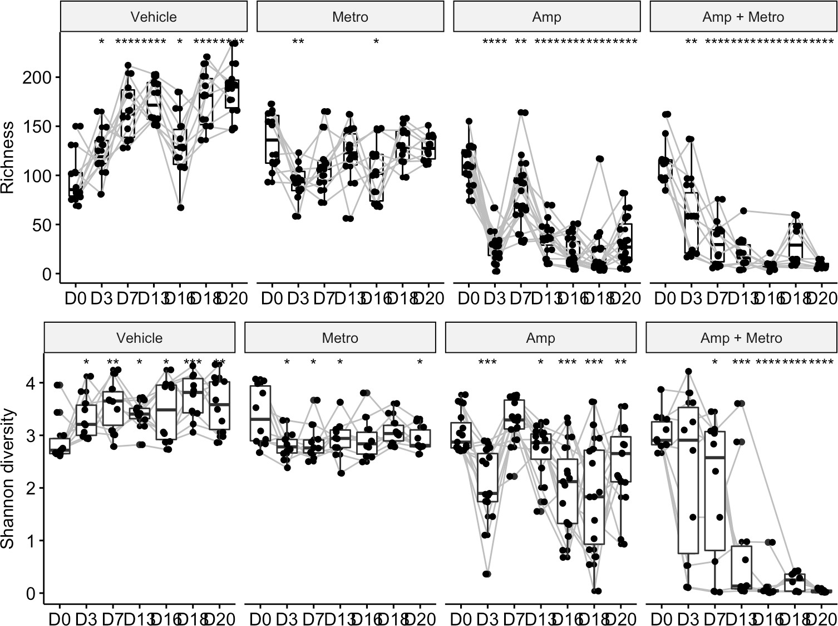
Richness Example

Slide 44
Beta Diversity
Between sample similarity
Distance between one sample to all other samples
Multivariant
Can incorporate relative abundances or not
Can incorporate phylogenetic information or not
Most frequently displayed in an ordination plot
To learn about distance measures and ordination: https://sites.google.com/site/mb3gustame/home

Slide 45
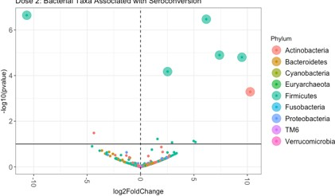
Differential Abundance Analysis
What specific taxa are different between study groups?
Lots of methods
DeSeq2
Random Forest
LeFse
ANCOM
Gneiss
…

Slide 46
Rest of today
Morning: Resolve sequence variants with dada2
Afternoon: Analyze antibiotic treated mice case study

Slide 47
Step 2: Initial error model
Step 1: Initial guess. All sequences + errors
Step 3: Unlikely error under model.
Recruit errors. Update the model
Step 3: Reject more sequences under new model & update
Convergence: All errors are plausible
Dada2: Callahan, BJ et al. Nat Methods. 2016

Slide 48
Dada2 workflow
Select Raw Data
QC Data
Learn Errors
Dereplicate
Infer ASV

